Slide 1
Unsupervised Image Segmentation using Graph Attention Networks
Under the supervision of:
Dr. Saurabh Shigwan
Tejaswi Manavala Narayanan
Shruti Bansal
Alla Guru Charan

Slide 2
Project Overview
AIM:
To implement unsupervised image segmentation using Graph Neural Networks (GNNs) in combination with Graph Attention Networks (GATs), and ultimately use this on medical images to get higher segmentation results.

Slide 3
Background Research
GNNs for Unsupervised Image Segmentation
Each image is converted to a graph representation:
Nodes: feature vectors of segments
Edges: similarities between nodes above a given threshold
Stored as an adjacency matrix
Encode both local and global similarities between image patches
Clusters of nodes with more internal connections are partitioned into segments

Slide 4
Background Research
Vision Transformers
Model used for image classification
Here, used for feature extraction
Images are treated as a sequence of patches, with each patch flattened into a vector
Graph Attention Networks
A variant of GNNs that incorporates attention mechanisms
Learns image patch embeddings by message-passing between nodes
More important neighbours contribute more to each final embedding

Slide 5
Setting Up the Environment
We first created a new python environment called as venv3.
We changed the execution policy for the process as RemoteSigned to execute commands without admin access.
Finally, we activate the environment.

Slide 6
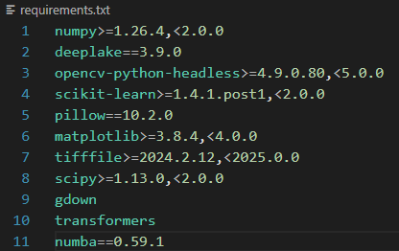
Installing Dependencies

Slide 7
Layer 1
pyg_nn.GCN
Looking at the 1st convolution layer:
pyg_nn.GCN(input_dim, 64, 1, act=act)
Here, we have fixed the number of input channels as 384, hidden channels as 64 and the number of message passing layers as 1.
However, the activation function is a parameter which keeps on changing.
Further, we need to experiment to find the right size and make it dynamic.

Slide 8
Layer 2
pyg_nn.GATConv
Looking at the 2nd convolution layer:
pyg_nn.GATConv(64, 32, heads=2, concat=True, dropout=0.4, negative_slope=0.2)
Here, we have fixed the number of input channels as 64, output channels as 32, number of multi-attention heads as 2 with output being concatenated instead of being averaged, dropout probability of normalized attention coefficients as 0.4 and the LeakyReLU angle of the negative slope as 0.2.
We are currently experimenting to find good values for these parameters.

Slide 9
Layer 3
pyg_nn.GCN
Looking at the 3rd convolution layer:
pyg_nn.GCN(64, conv_hidden, 1, act=act)
Here, we have 64 input channels, 64 hidden channels and 1 message passing layer.
As in the 1st layer, the activation function is a parameter which keeps on changing.

Slide 10

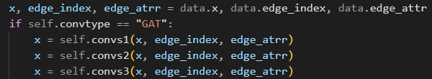
GAT Convolution
Gnn_pool.py -> class GNNpool ->
__init__(self, input_dim, conv_hidden, mlp_hidden, num_clusters, device, activ, loss_type, conv_type)
forward(self, data, A)

Slide 11
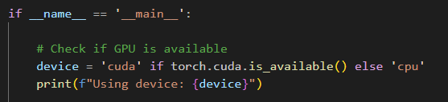
Added a check for GPU in the main file

Slide 12
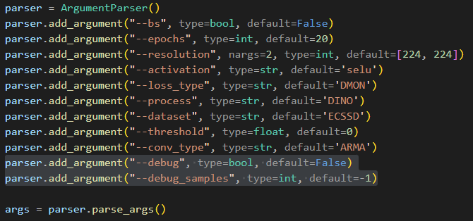
Created Debug
Parameters
Added debug and debug_samples parameters to better debug images with lower IoU.

Slide 13
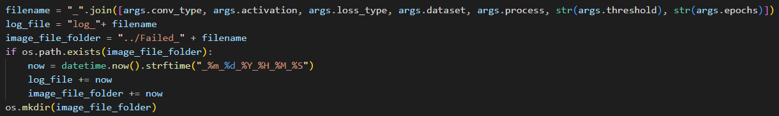
Created custom files and folders for debugging

Slide 14
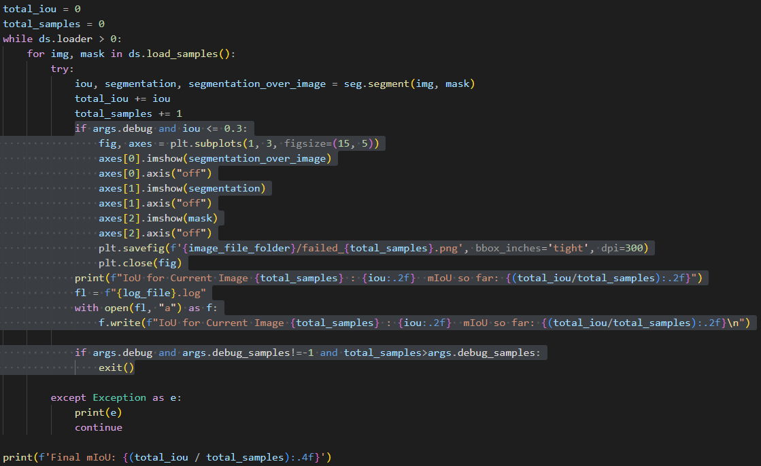
Storing failed images for debugging

Slide 15
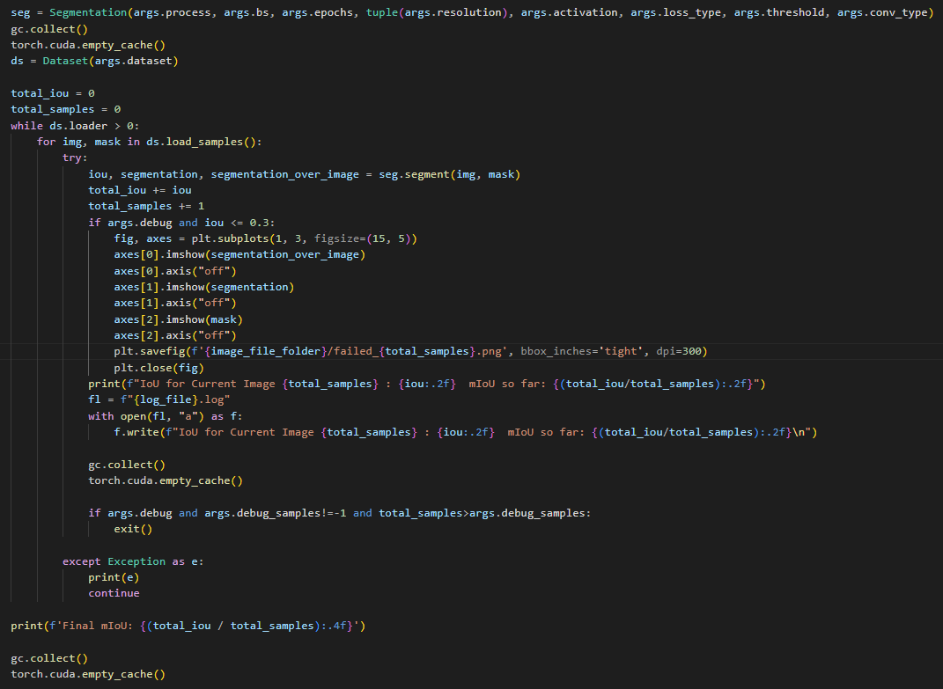
Implemented Garbage Collector using in-built gc library in python and cuda in torch

Slide 16
Process Flow
Image is loaded
Feature extraction using ViT
Graph representation created
Graph passed through the GCN+GAT combination
Masks created
Overlay the produced mask on the original image, and measure the IoU

Slide 17
Experiments Run
ARMA filter + threshold 0.1 + DMON loss + DUTS + relu activation
ARMA filter + threshold 0.1 + NCUT loss + DUTS + relu activation
ARMA filter + threshold 0.3 + DMON loss + DUTS + selu activation
ARMA filter + threshold 0.3 + DMON loss + ECSSD + selu activation
GCN + GAT + threshold 0.3 + DMON loss + ECSSD + selu activation
GCN + GAT (64,32,2) + GCN + threshold 0.3 + selu activation + NCUT loss
GCN + GAT (64,32,2) + GCN + threshold 0.2 + selu activation + NCUT loss

Slide 18
Observations
The experiments run with the ARMS filters with 0.3 threshold give the expected values from the UnSegARMANet paper. (~0.71 mIoU)
So far, with the tested parameters, the GCN + GAT + GCN combinations have resulted in mIoUs ~0.68
We hope to improve these results by varying other parameters such as the number of heads and the threshold

Slide 19
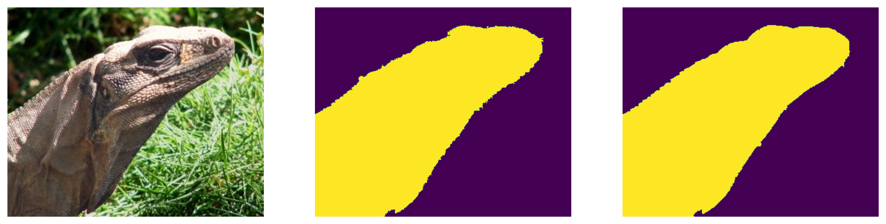
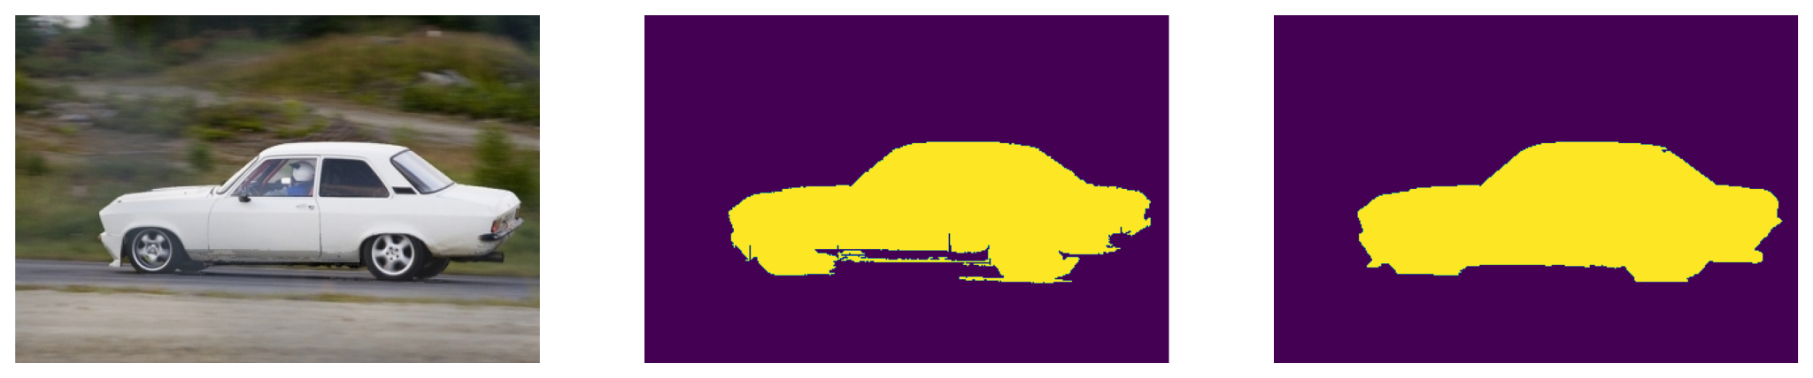
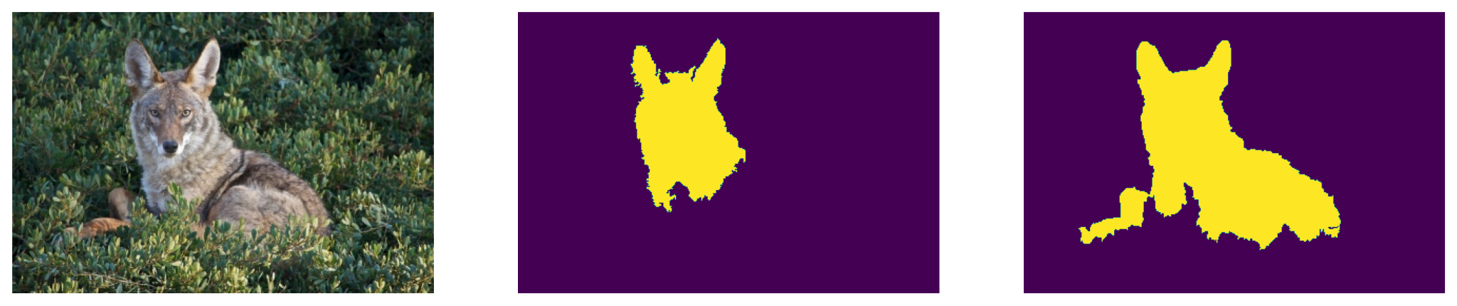
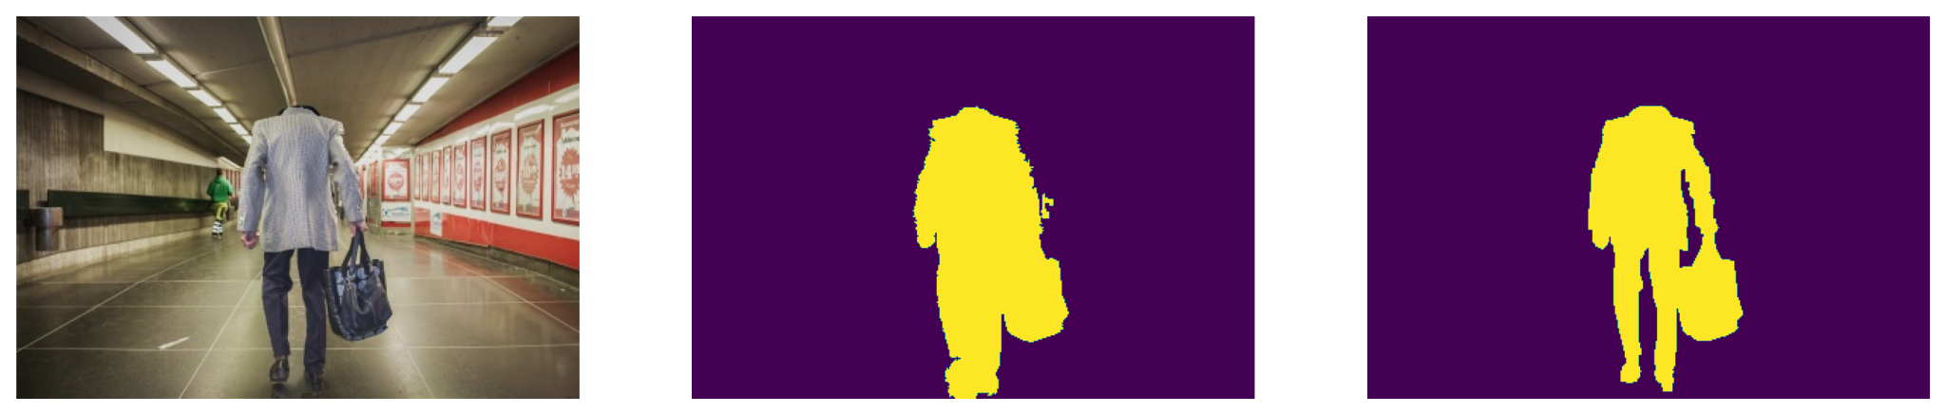
Some
Examples
from
GAT Convolution
Experiment

Slide 20
Challenges
Matching up the pyTorch and cuda versions with the available GPU
Taking care of the GPU memory utilization
Adjusting the GCN and GAT input and output layers to avoid shape errors
System shut-downs due to problems with memory allocation

Slide 21
THANK
YOU

